Slide 1
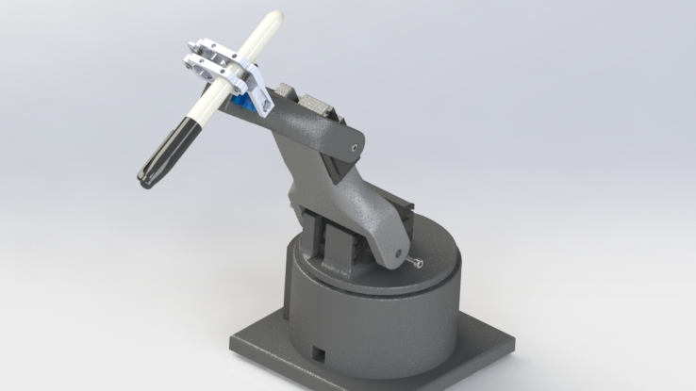
Homework #3: drawBOT
Robotic Arm
Group 6: Stephanie Bentley, Allison Moore, Jack Amsbry
10/12/2021

Slide 2
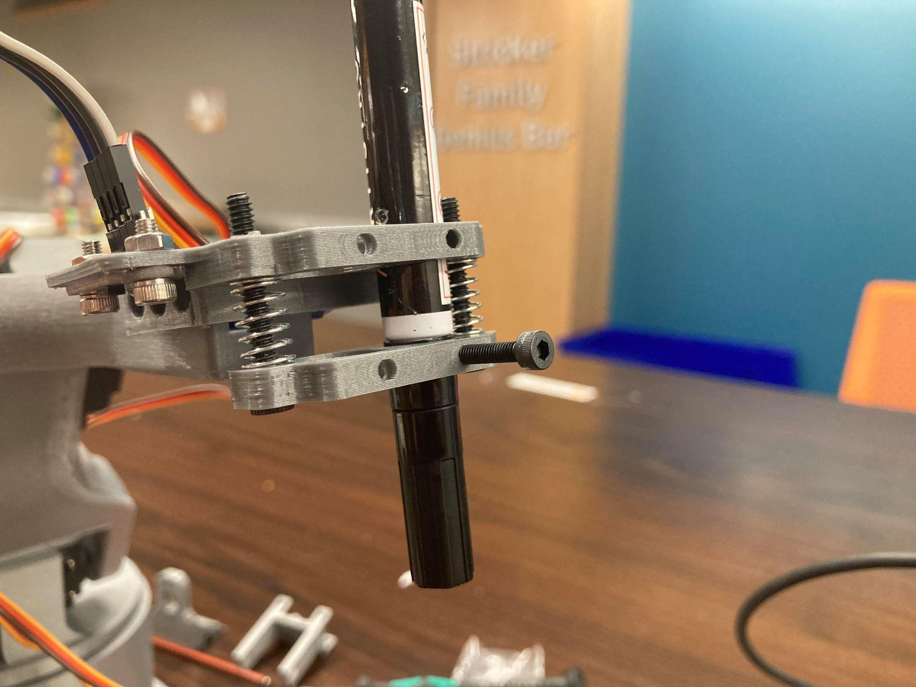
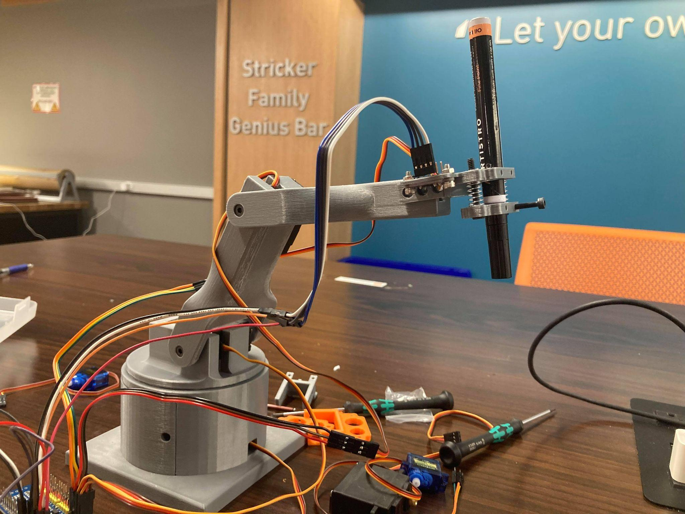
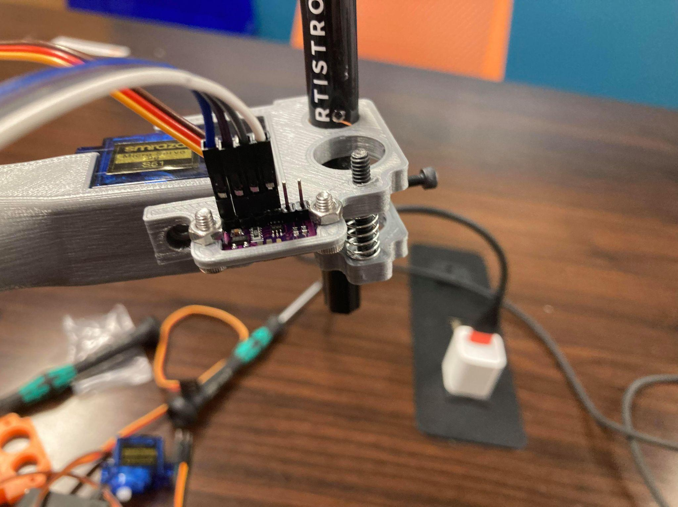
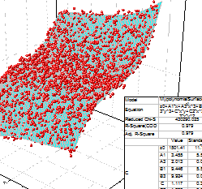
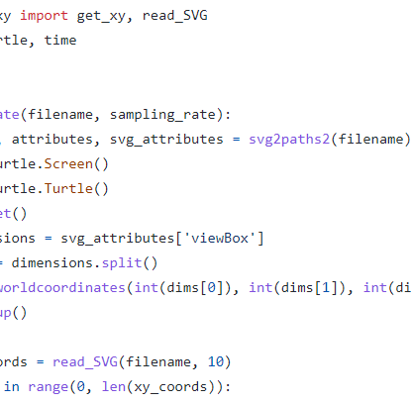
Creativity & Innovation
Presented by: Jack
Compressive Pen Mount
Lidar
Sensing
Polynomial Surface Fit of Z Data
Dynamic 4-Bar Linkage
Adaptable SVG Parsing
Notes:
Polynomial Surface Fit of Z Dara

Slide 3
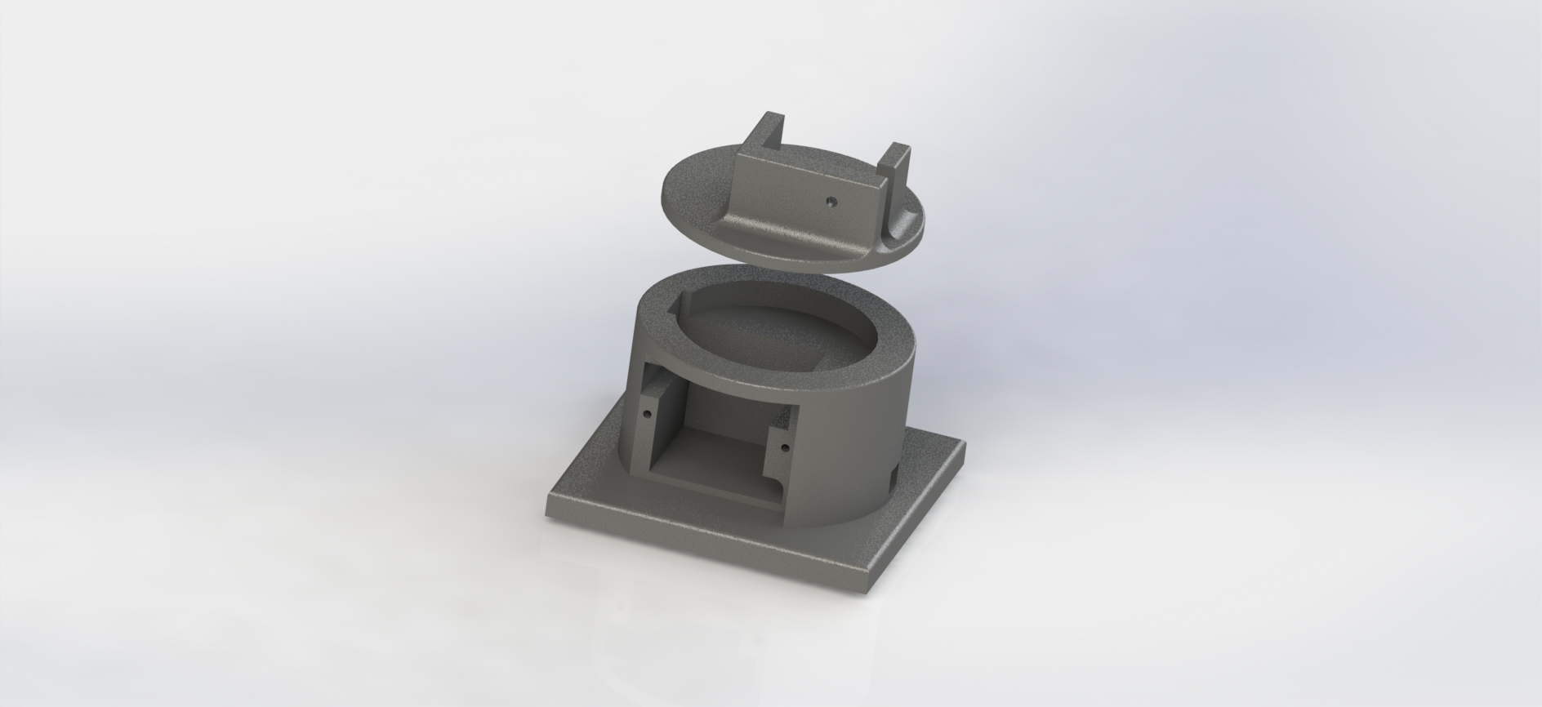
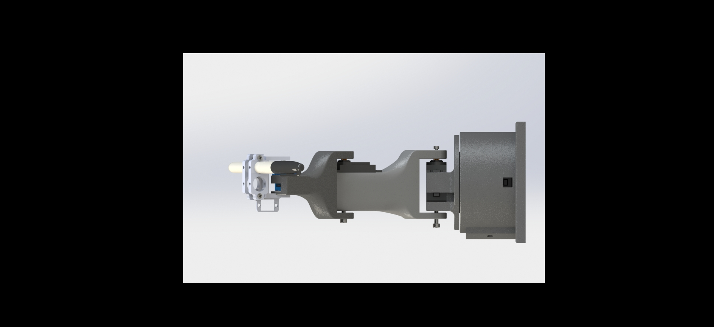
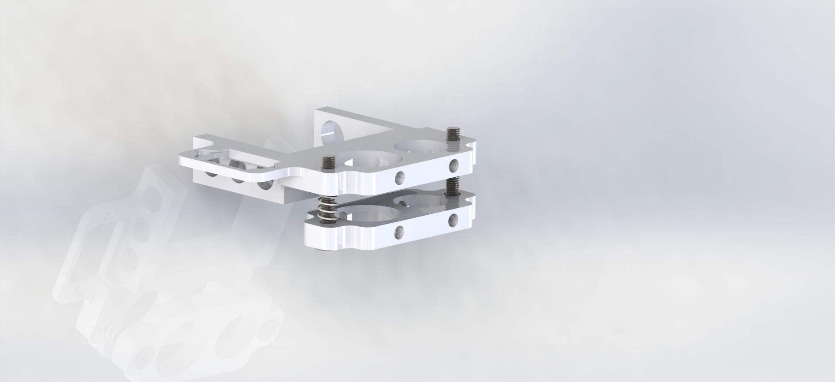
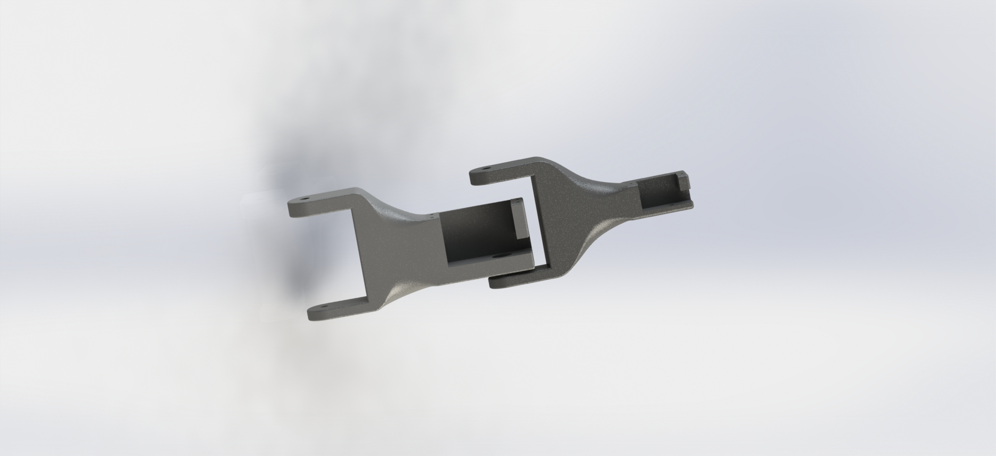
Design & Fabrication
Presented by: Allison

Slide 4
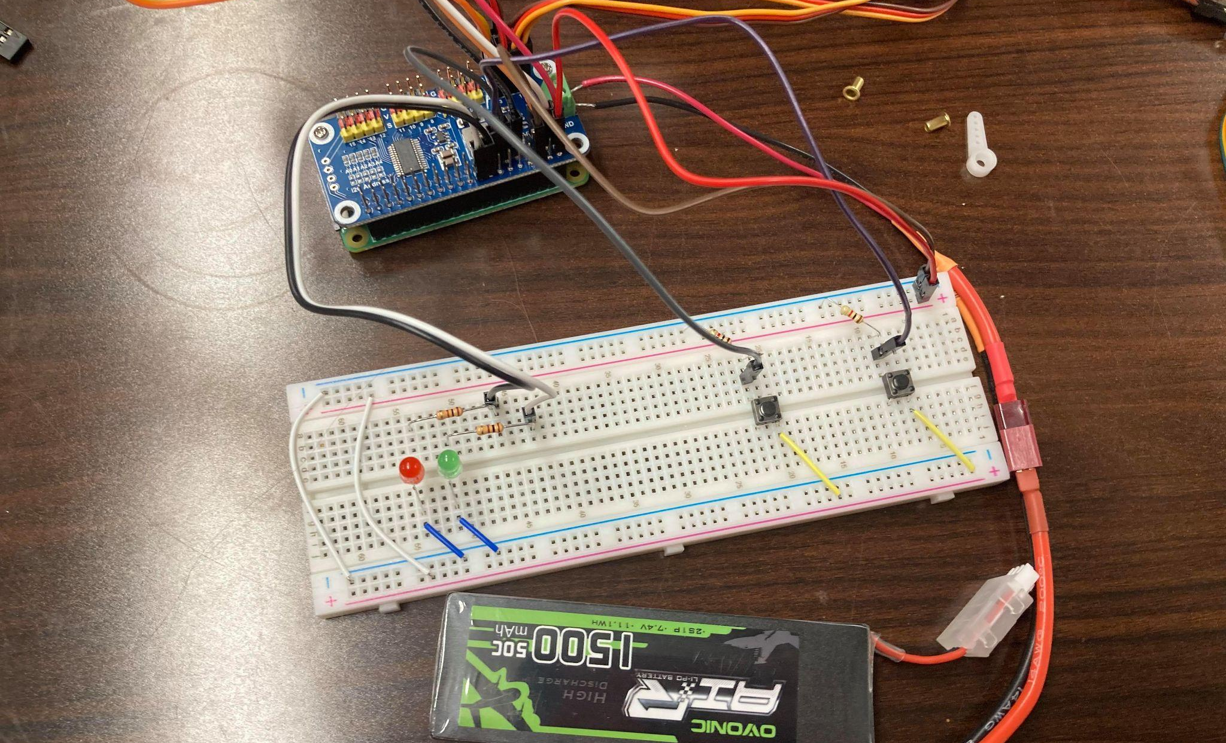
Electronics
Presented by: Jack

Slide 5
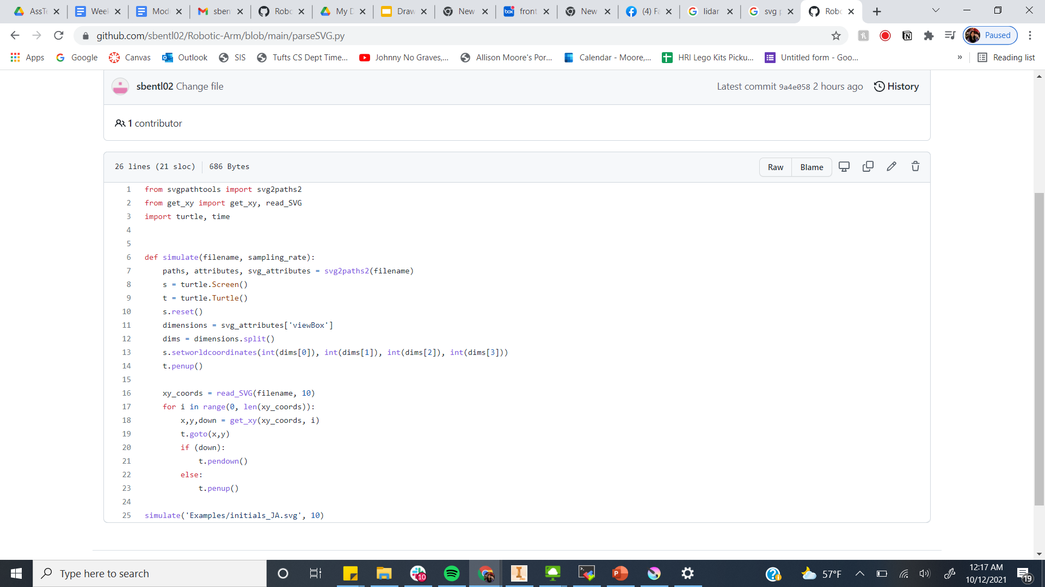
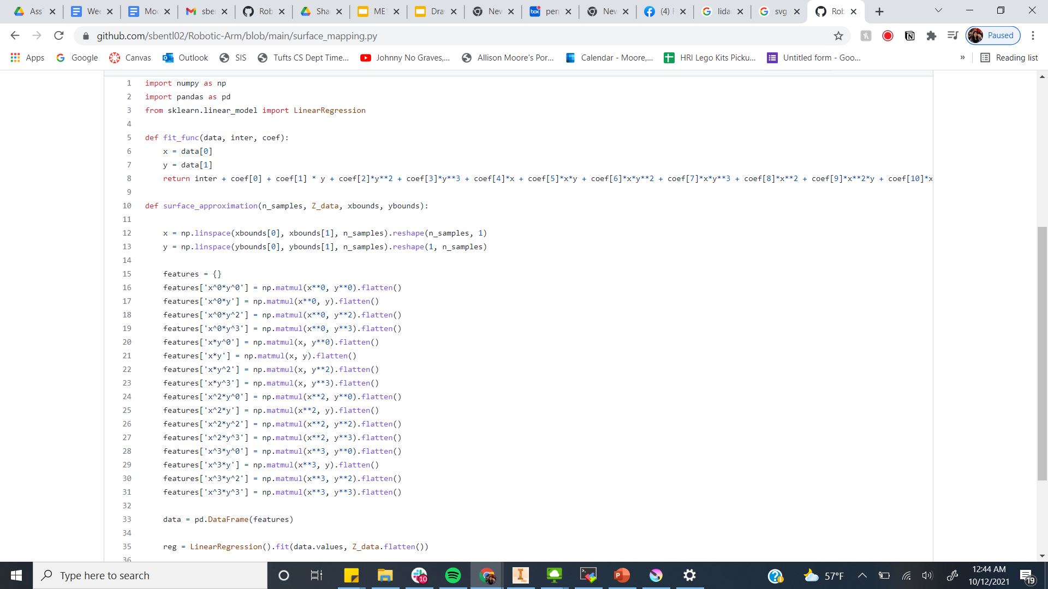
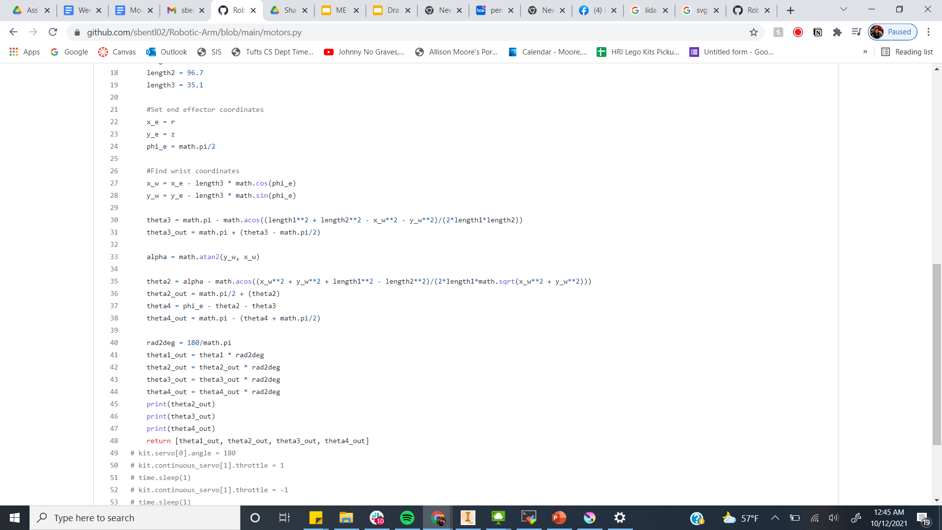
Coding
Presented by: Jack
SVG File Parsing
Polynomial Surface Mapping
Inverse Kinematics
Presented by: Stephanie

Slide 6
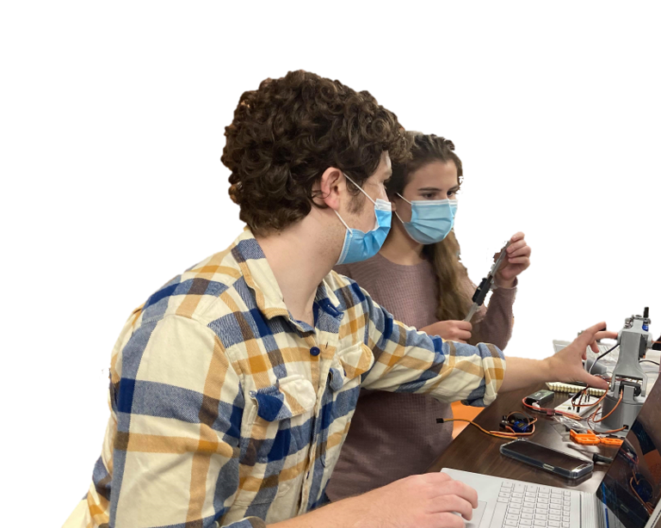
Wow! This was hard!
Redesigning linkages to be simpler
Inverse Kinematics
SVG Parsing File Adaption
It’s drawing things backwards??
The Laser Cutter is Broken :(
Adaptable Effector
Torque too weak to support arm weight
Github Connection :(
Out of Range Angles
Presented by: Stephanie

Slide 7
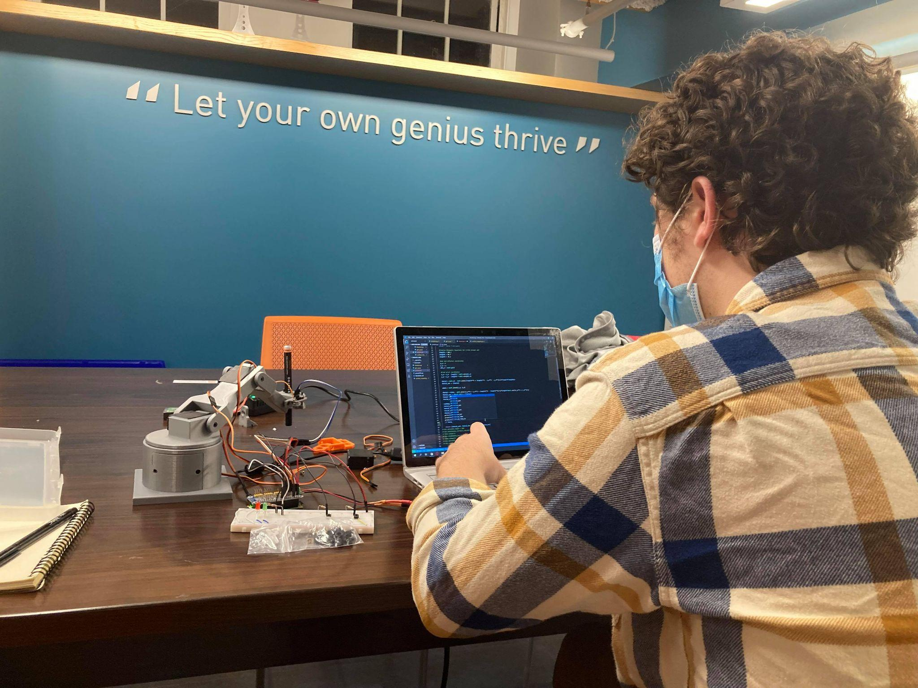
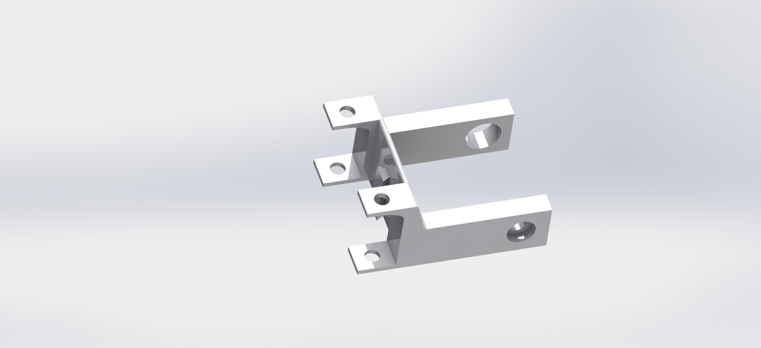

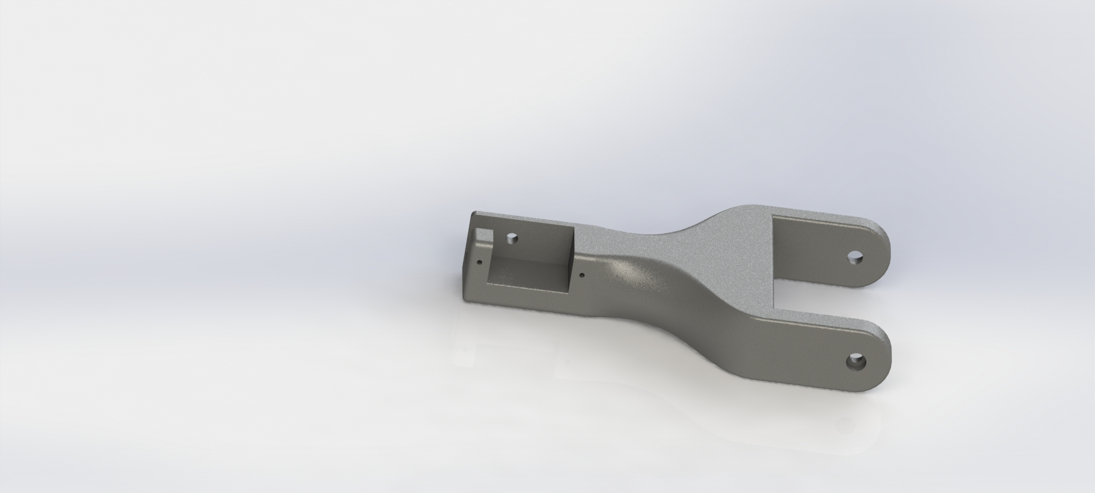
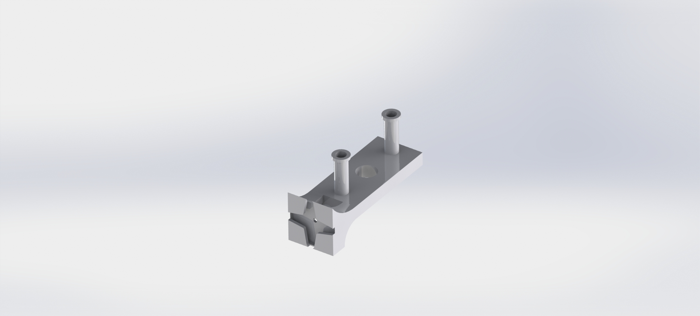


We redesigned a ton. Some examples….
End Effector Design
Calibrating Motors
Remade linkage to make inverse kinematics easier
...And MUCH more :,)
Making SVG Parsing in range
Presented by: Allison

Slide 8
Thank you!
Questions?

